Slide 1
제 8회 인공지능 및 로보틱스 여름학교 AI & Robotics Summer School 2023 딥러닝 이론 - Classification
AILAB
School of Integrated Technology (SIT)
Gwangju Institute of Science and Technology (GIST)

Slide 2
Index
Basic Model Structure
Multi Layer Perceptron
Fully Connected Layer
Convolutional Neural Network
Convolutional Layer
Channel, Kernel, Padding, Pooling
Activation function
Training & Evaluating Classification Model
Back Propagation
Gradient Descent
Chain Rule
Data Split
Train / Val / Test
Overfitting
Overfitting

Slide 3
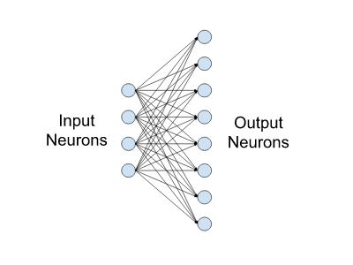
Multi-Layer Perceptron
Fully Connected Layer
Fully Connected Layer is a one of the type of layer in neural network which all neurons of the previous layer is connected to every neuron in the next layer.
In fully connected layer, each output is produced by all input neurons combined with corresponded weights. Networks can find and learn complex relationships between input and output by tuning these weights during training.
Example of a small fully-connected layer with four input and eight output neurons.
https://docs.nvidia.com/deeplearning/performance/dl-performance-fully-connected/index.html

Slide 4
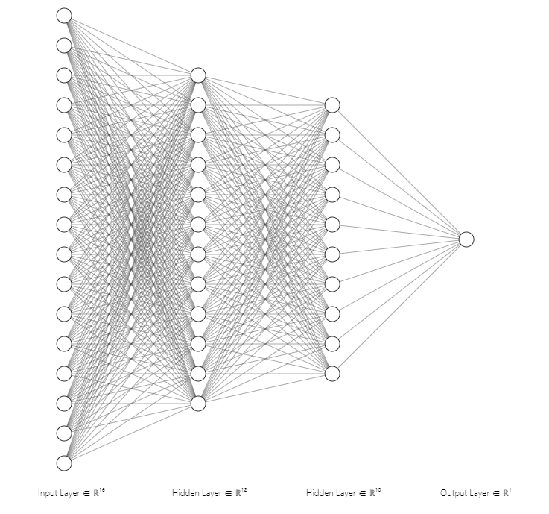
Multi-Layer Perceptron
Multi-Layer Perceptron
Multi Layer Perceptron, MLP is a neural network that composed of multiple fully connected layers.
The first layer that receives input data is input layer and last layer that makes final output is output layer. Layers between input layer and output layer are called hidden layer.
MLP is highly versatile that can be almost any functions and can handle various categories of data. However, it can be computationally expensive and time consuming. Also it could be difficult to tune the parameters and there are risks of overfitting and lack of interpretability.
Example of Multi-Layer Perceptron
https://alexlenail.me/NN-SVG/index.html

Slide 5

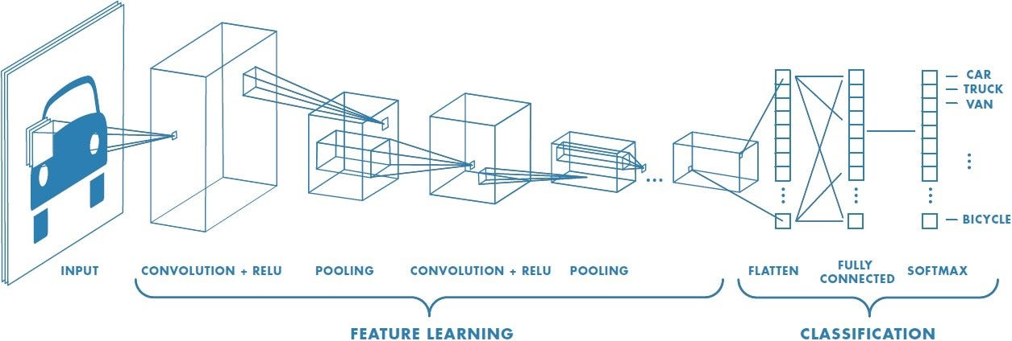
Convolutional Neural Network
Convolutional Layer
A Convolutional Neural Network is a Deep Learning algorithm which can take in an input image, assign importance (learnable weights and biases) to various aspects/objects in the image and be able to differentiate one from the other.
The role of the ConvNet is to reduce the images into a form which is easier to process, without losing features which are critical for getting a good prediction.

Slide 6
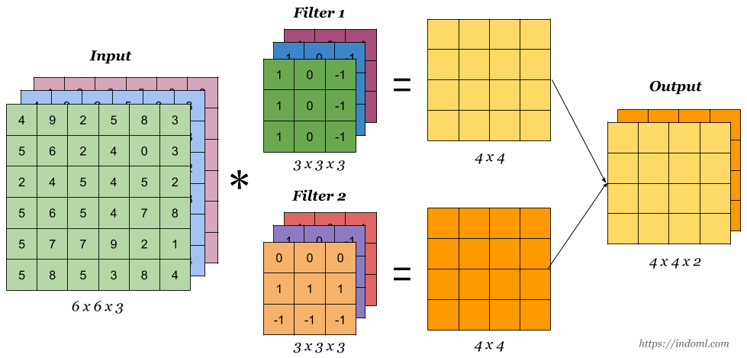
Convolutional Neural Network
Kernel
Kernel, also called filter, is fundamental element of a neural network which is a small matrix used to perform convolutional operations on input data.
Kernel acts like a feature extractor, detecting patterns and capturing information from the input data.
In one convolutional layer, there can be multiple kernels and each kernel makes one output matrix. Therefore the number of kernels in a layer is equal to the number of output channels.

Slide 7


Convolutional Neural Network
Channel, Kernel size, and Stride
Stride

Slide 8
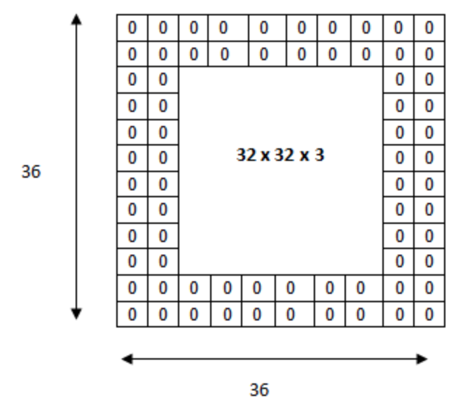
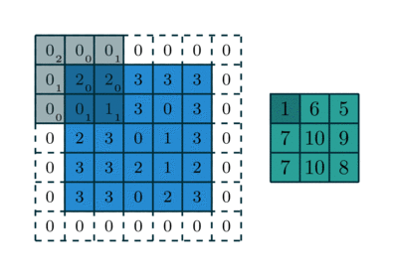
Convolutional Neural Network
Padding
Padding is process that adding extra elements (usually zero) to the around of the input data before convolutional operations.
The one major purpose of padding is regulating input data size for preventing size of input data does not become too small that losing almost of information.
The second reason is to make the information more available in edge of inputs. Due to characteristic of convolution operation, information at the edge is not much considered relatively. Padding reduces this limitation of convolutional operations.

Slide 9
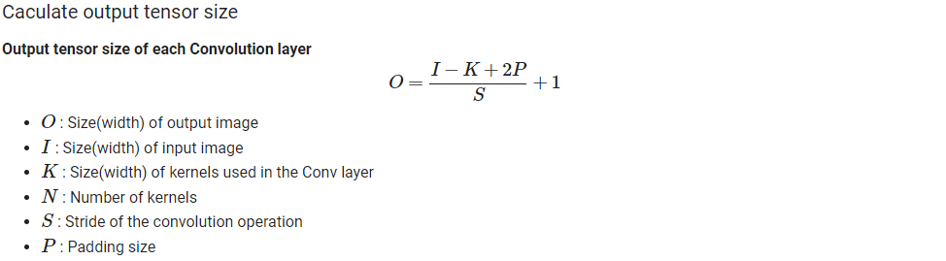
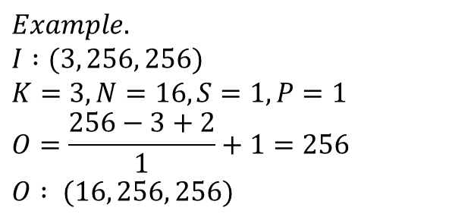
Convolutional Neural Network
Output Size
$$Example.$$
$$I :(3, 256, 256)$$
$$K=3, N=16, S=1, P=1$$
$$O=\frac{256−3+2}{1}+1=256$$
$$O : (16, 256, 256)$$

Slide 10
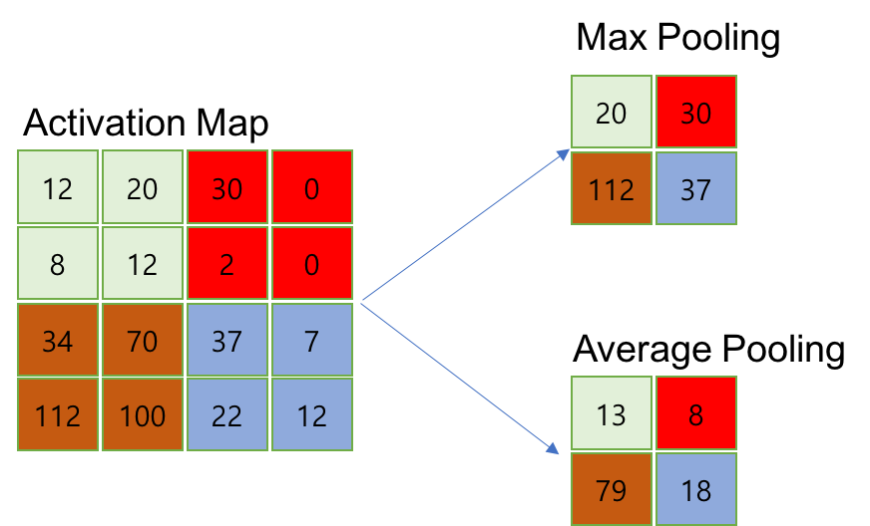
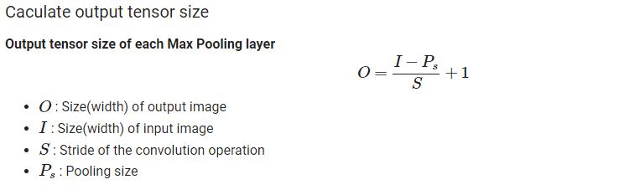
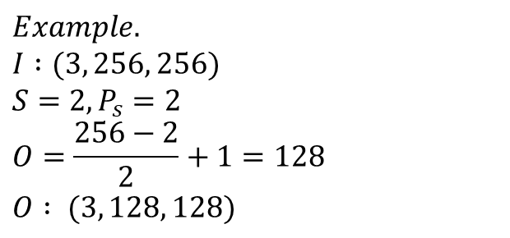
Convolutional Neural Network
Pooling
$$Example.$$
$$I :(3, 256, 256)$$
$$S=2, P_{s}=2$$
$$O=\frac{256−2}{2}+1=128$$
$$O : (3, 128, 128)$$

Slide 11
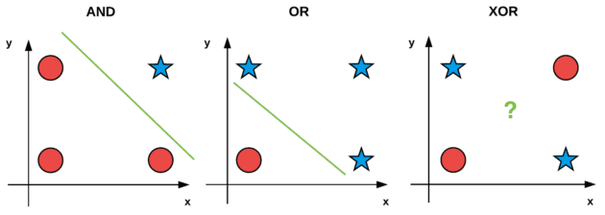
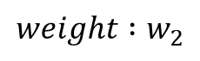
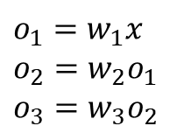
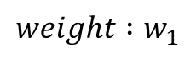
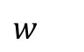
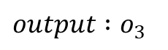
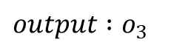
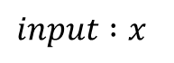
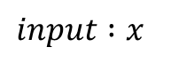
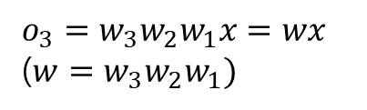
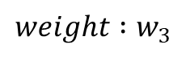
Convolutional Neural Network
Activation Function
Activation function gives the model nonlinearity and makes model can learn complex nonlinear relationship between inputs and outputs. (ex. XOR problem)
Nonlinearity in deep neural network is important because without non-linear functions, every multiplications of matrices can be express as single matrix which means losing meaning of stacking multiple layers.
ReLU, Sigmoid, Tanh, Softmax are representative activation functions that commonly used in neural networks.
$$input :x$$
$$weight :w_{1}$$
Layer 1
$$input :x$$
$$weight :w_{2}$$
Layer 1
Layer
$$w$$
$$weight :w_{3}$$
Layer 1
$$output :o_{3}$$
$$output :o_{3}$$
$$o_{1}=w_{1}x$$
$$o_{2}=w_{2}o_{1}$$
$$o_{3}=w_{3}o_{2}$$
$$o_{3}={w_{3}w_{2}w}_{1}x=wx$$
($w={w_{3}w_{2}w}_{1})$
Example of simple gate problem

Slide 12
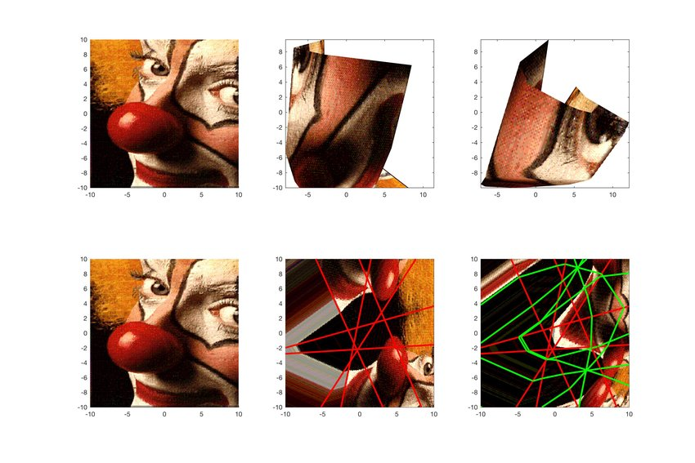
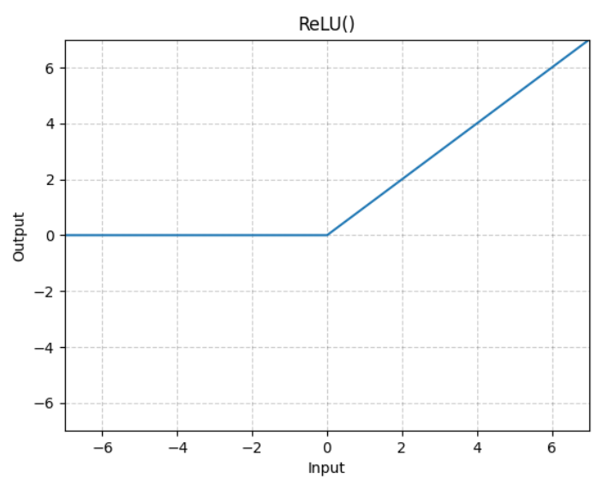
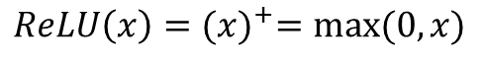
Convolutional Neural Network
Activation Function
$ReLU\left(x\right)={(x)}^{+}=max⁡(0,x)$
Visualization of the function computed by a ReLU network
ReLU(Rectified Linear Unit) is the one of the most popular activation function which is linear for positive values and zero for negative values.
Montúfar, Guido. "Notes on the number of linear regions of deep neural networks." (2017).

Slide 13
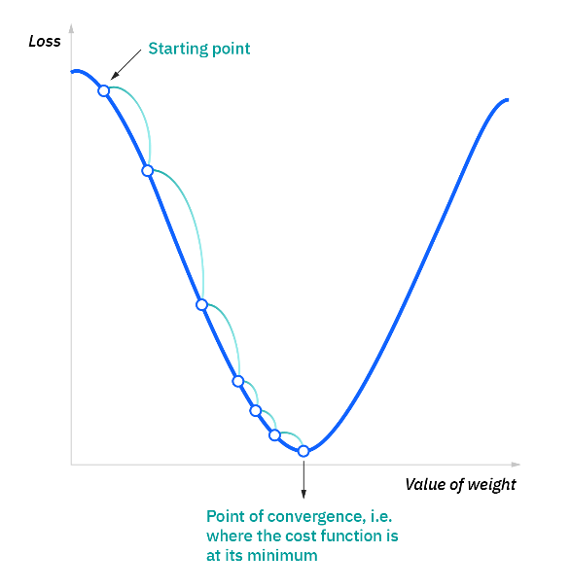
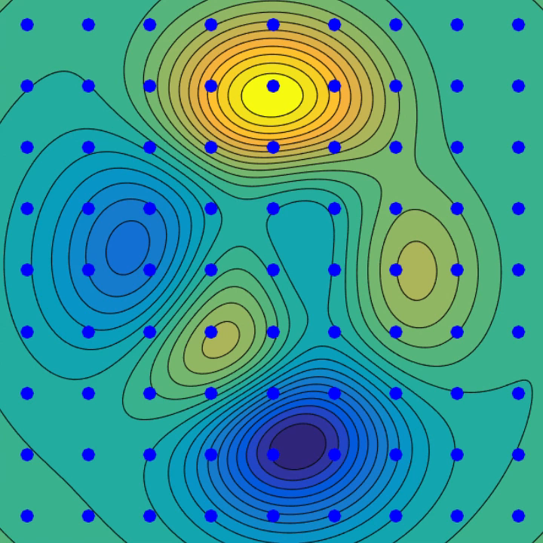
Back Propagation
Gradient Descent
Deep learning model calculated the loss, difference of the model prediction and ground truth to know current error of the model and to update the model parameters during training by minimizing the loss.
The mathematical equation that calculated loss is loss function and basically loss function is the differentiable function. Because to update model parameters we need to calculate ‘gradients’.
Gradient is partial derivatives of a function with respect to its parameters. During training, gradient is computed by performing back propagation. After gradients are computed, they are used to update the model parameters by optimization algorithm.
Gradient Descent in 2D
Gradient Descent in 2D

Slide 14
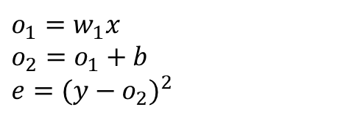
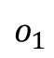
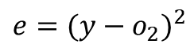
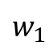
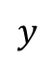
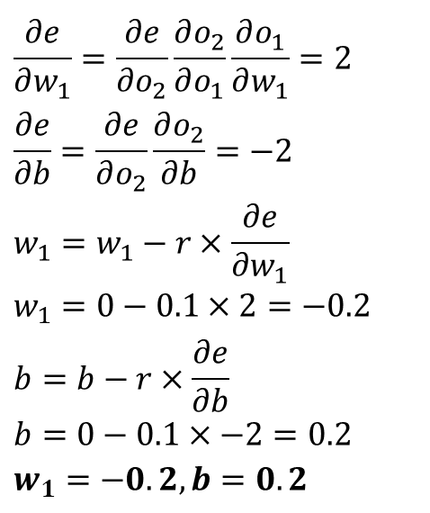
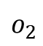
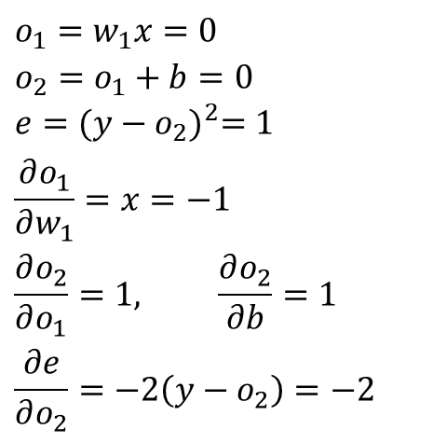
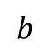
Back Propagation
Chain Rule
x
$$if x=−1, y=1, w_{1}=0,b=0, and Learning Rate, r=0.1$$
MUL
$$o_{1}$$
$$w_{1}$$
$$o_{1}=w_{1}x=0$$
$$o_{2}=o_{1}+b=0$$
$$e{=(y−o_{2})}^{2}=1$$
$$\frac{∂o_{1}}{∂w_{1}}=x=−1$$
$$\frac{∂o_{2}}{∂o_{1}}=1, \frac{∂o_{2}}{∂b}=1$$
$$\frac{∂e}{∂o_{2}}=−2\left(y−o_{2}\right)=−2$$
$$\frac{∂e}{∂w_{1}}=\frac{∂e}{∂o_{2}}\frac{∂o_{2}}{∂o_{1}}\frac{∂o_{1}}{∂w_{1}}=2$$
$$\frac{∂e}{∂b}=\frac{∂e}{∂o_{2}}\frac{∂o_{2}}{∂b}=−2$$
$$w_{1}=w_{1}−r×\frac{∂e}{∂w_{1}}$$
$$w_{1}=0−0.1×2=−0.2$$
$$b=b−r×\frac{∂e}{∂b}$$
$$b=0−0.1×−2=0.2$$
$$w_{1}=−0.2, b=0.2$$
ADD
$$o_{2}$$
$$b$$
Loss
$$e{=(y−o_{2})}^{2}$$
$$y$$
$$o_{1}=w_{1}x$$
$$o_{2}=o_{1}+b$$
$$e{=(y−o_{2})}^{2}$$

Slide 15
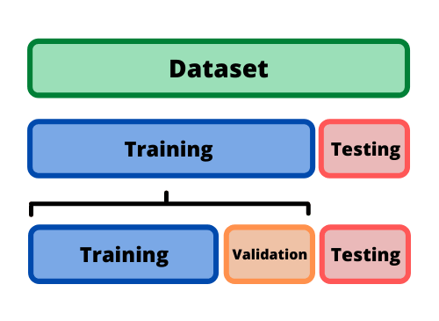
Data Split
Train / Val / Test
To train and evaluate the model, we need to split the dataset we have.
Usually, we divide dataset in to 3 parts such that Train Set, Validation Set, and Test Set.
Train Set is used for training model during train step.
Validation Set is used for evaluating model and select best parameters of model during train step.
Test Set is used for evaluating final performances of model in evaluation step.

Slide 16
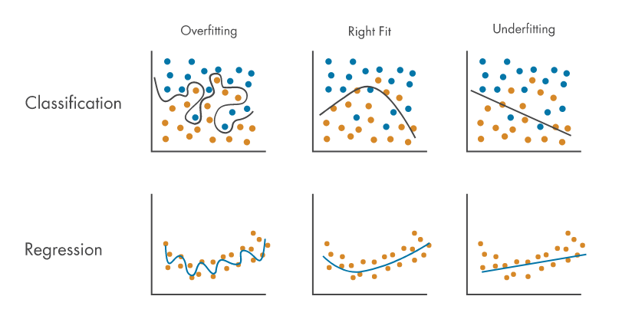
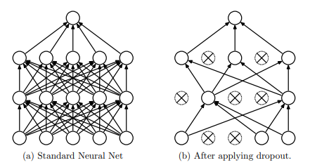
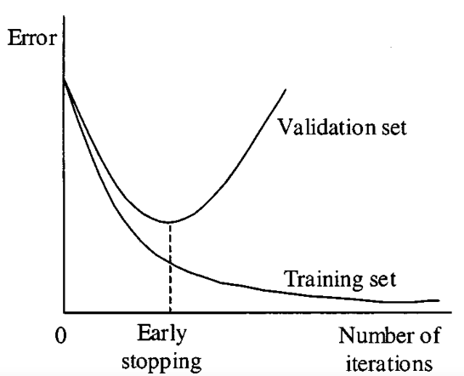
Overfitting
Overfitting
Overfitting is the phenomenon that model learns to fit the training data so closely that starts to memorize specific examples and patterns in the training data.
Overfitting means that model loss the generality of the data distribution and can not make prediction well for unseen data.
To prevent overfitting there are several techniques like Regularization, Early Stopping and Drop Out.
https://kr.mathworks.com/discovery/overfitting.html
Drop Out
Early Stopping
Srivastava, Nitish, et al. "Dropout: a simple way to prevent neural networks from overfitting
https://paperswithcode.com/method/early-stopping

